Slide 1
Lecture # 4:
Justice and Fairness
Instructor
Dr. Shahnawaz Muhammad Khan

Slide 2
WHAT IS JUSTICE?

Slide 3
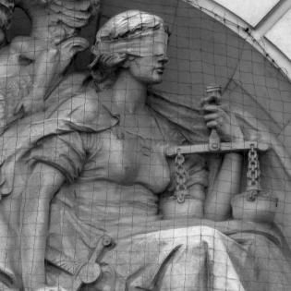
Interpret the Symbol of Justice

Slide 4
IS JUSTICE ABOUT….
Equality?
Fairness?
Getting what we Deserve?
Or getting what we Need?

Slide 5
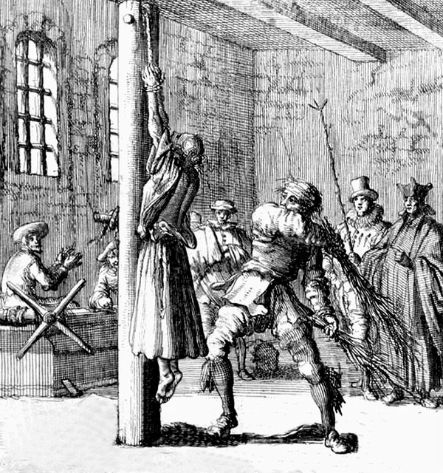
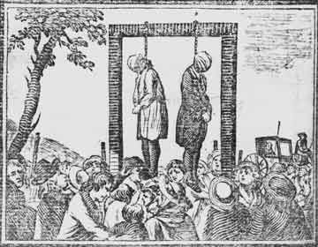
Eye for Eye
Tooth for Tooth

Slide 6
RETRIBUTIVE JUSTICE
Crime and Punishment
Also called as ‘Criminal Justice’
“Let the punishment fit the crime”
Severity of penalty for a misdeed and wrongdoing should be reasonable and proportionate to the severity of the infraction

Slide 7
DISTRIBUTIVE JUSTICE
Benefits and Burdens
Fair and proper distribution of public benefits and burdens
Benefits = wealth, goods, privilege & power
Burdens= work & cost to be paid for development of society

Slide 8
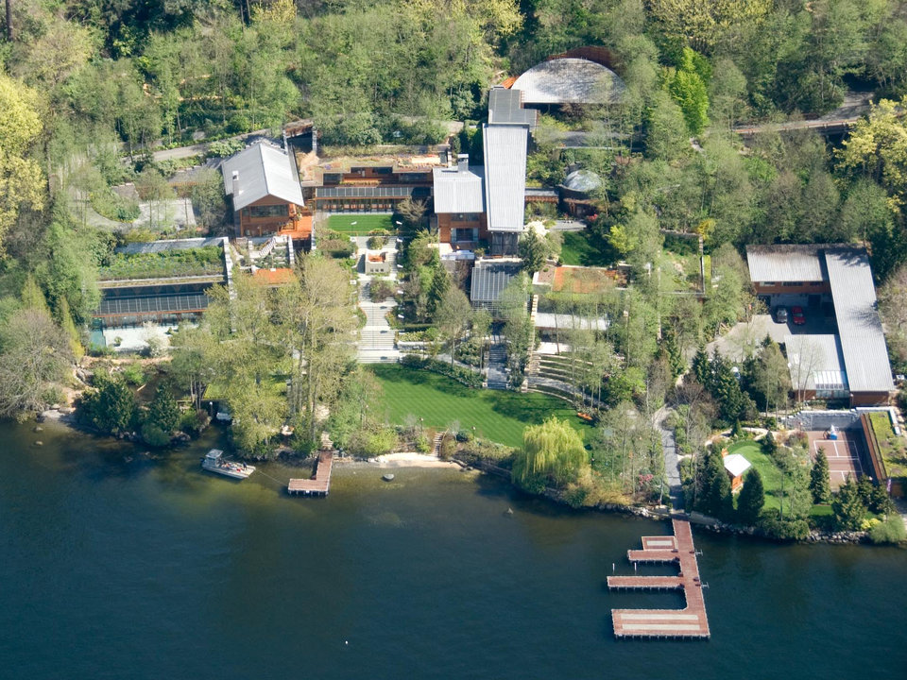
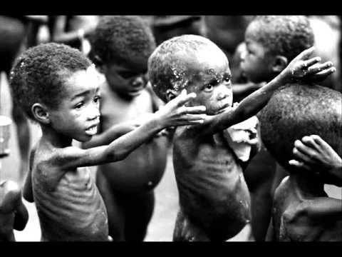
Is this Fair?

Slide 9
The owner of a small office supply store has two employees, Mike and Bill. They are equally productive and hardworking and are both currently earning $7 per hour. The owner decides to move his store to a new location nearby where he knows business will be better. He lets his workers know that if they wish to continue at the new location he will be able to raise their wage. He explains that they will continue to have the same responsibilities but that one worker will earn $8 per hour and the other $12 per hour. He also explains that which worker gets the higher wage will be determined later on the basis of a coin toss. The workers can choose to go with the owner to the new location under these terms or to find similar work elsewhere for their current $7 per hour. They both choose to go with the owner.
Fair?

Slide 10
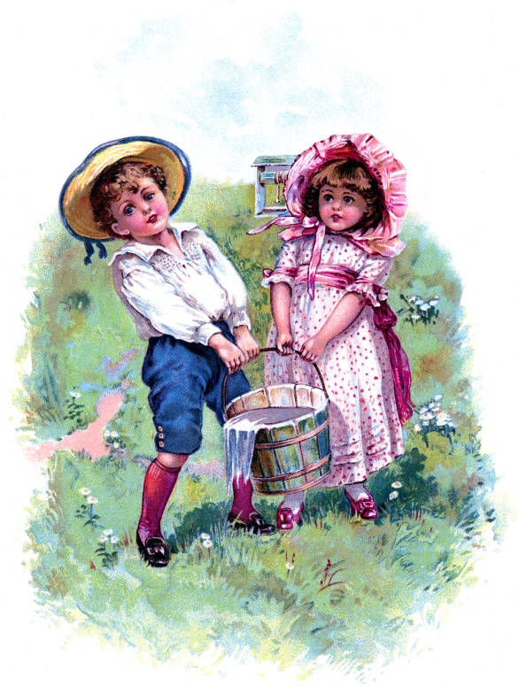
Example
Jack and Jill carry the same amount of water for us.
Should we pay them the
same amount of money?
Should we pay Jack more
because he is a man?
Should we pay Jill more
because she is white
and Jack is not?

Slide 11
What if Jill carries a bucket
of water for us that is twice
as big as Jack’s?

Slide 12
FORMAL JUSTICE
We should treat two cases the same when they are the ‘same’.
Differences based on gender, race and age are irrelevant.
The amount of work that people do is relevant to how much each should get.

Slide 13
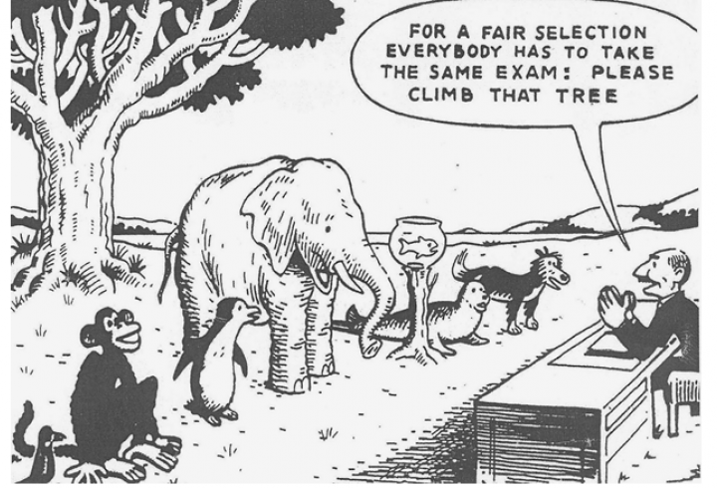
JUSTICE OR NOT?

Slide 14
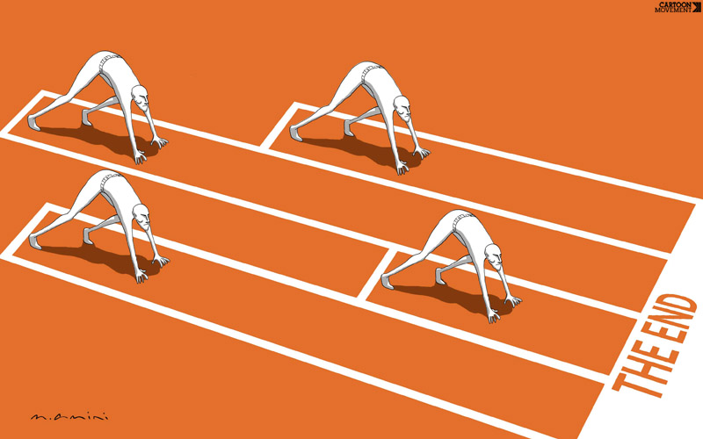
JUSTICE OR NOT?

Slide 15
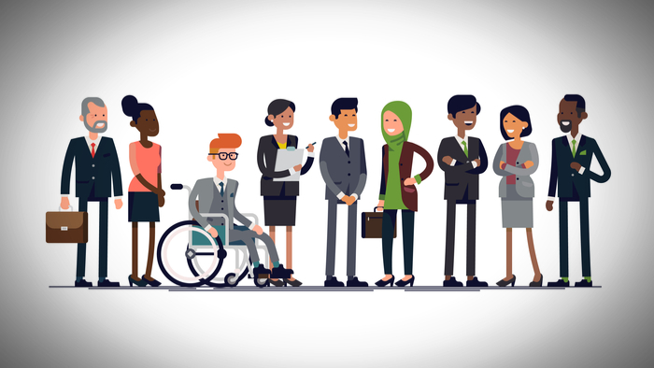
JUSTICE OR NOT?

Slide 16
Activity:
Have you ever said, “That’s unfair”?
How do you know when something is unfair?
Make a list of Do’s and Don’t for being unfair.

Slide 17
KINDS OF JUSTICE
What is Social Justice?
What is Political Justice?
What is Economic Justice?

Slide 18
SOCIETY AND THE BOMB
https://www.youtube.com/watch?v=XX63b1sJtoc

Slide 19
SOCIETY AND THE BOMB
Is killing the innocent always wrong, no matter the consequences?
Would you support the morality of dropping the bomb?
Do you agree that in some circumstances the use of weapons of mass destruction is morally permissible?

Slide 20
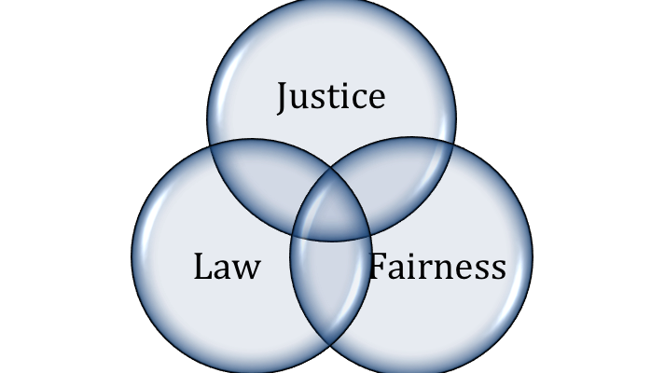
THEORIES OF JUSTICE

Slide 21
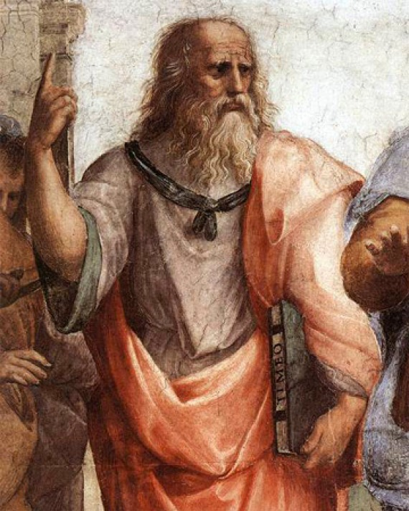
JUSTICE AS MERIT - PLATO
Justice as Harmony
A Just Society is one in
which everyone fulfills
their roles, so that
society runs smoothly.

Slide 22
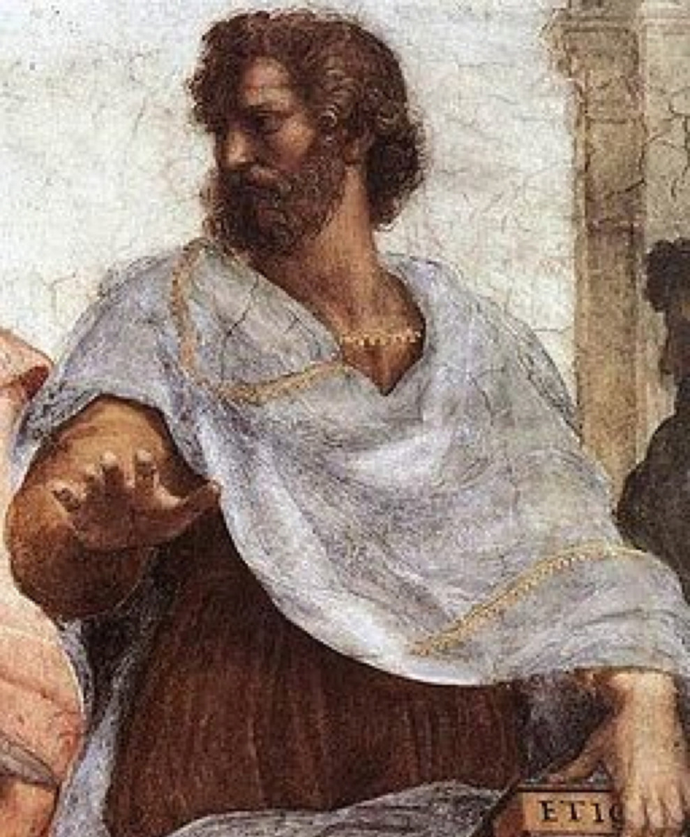
JUSTICE AS MERIT - ARISTOTLE
Justice as Partiality
Abilities, social status
and achievements of
People entitled them
to different treatment
and different positions
in society.

Slide 23
Activity:
Think of a time when you've taken unfair advantage of a person or a situation, or when someone has taken unfair advantage of you.
Describe it. What was unfair about it?
How did it make you feel?
What did you learn from the experience?
How should you treat people who are not fair with you?

Slide 24
JUSTICE AS EQUALITY
All men are created equal.
In a just society, every person will be given exactly equal shares of the society’s burdens and benefits.

Slide 25
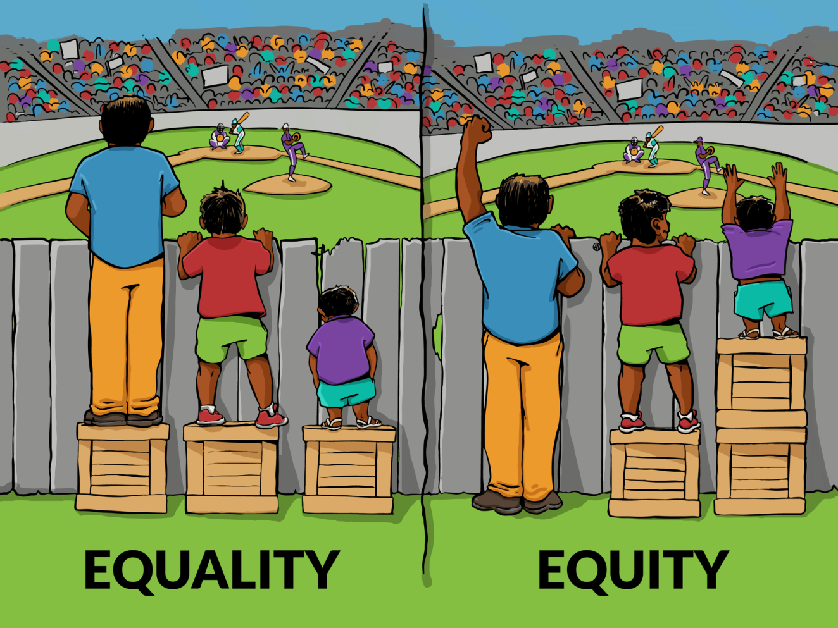
ARE JUSTICE AND EQUALITY SAME?

Slide 26
STRICT EGALITARIANISM
Everyone who needs an organ should have
an equal chance of getting one.
Suppose that 2 people need the only heart
available.
Who will you give the heart?
PERSON 1 | PERSON 2
A renowned neurosurgeon in her late forties whose survival promises to benefit countless persons | A sixty-five year old derelict who for decades has abused his body and whose survival will benefit no one except himself.

Slide 27
JUSTICE AS SOCIAL UTILITY
Maximization of social benefits and minimization of social harm.
People interpret justice in terms of ‘UTILITY’.

Slide 28
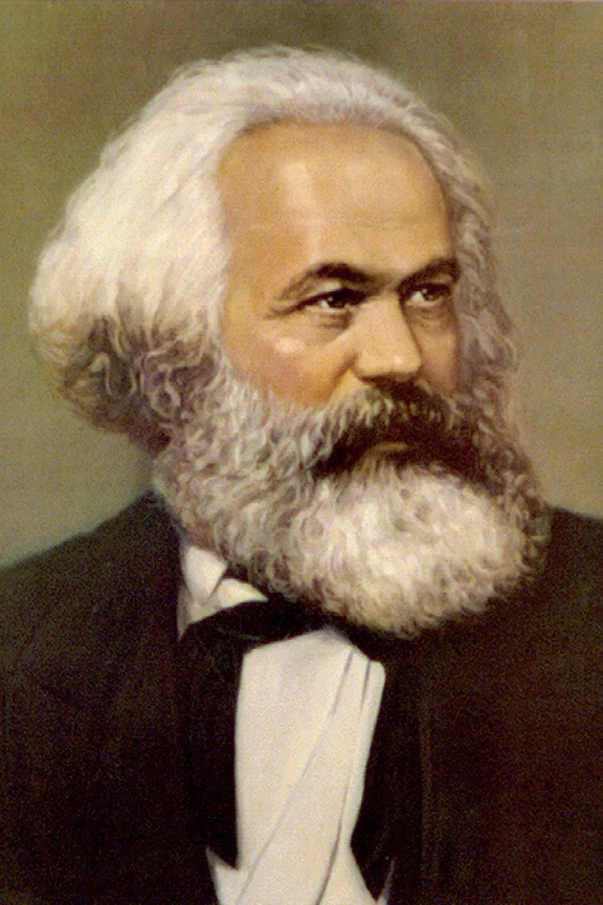
JUSTICE BASED ON NEED AND ABILITY
The wealth the society
produces belongs to
everyone and so should
be shared by everyone.
Government ownership
of all productive enterprises.
“From each according to
his ability to each according
to his need.” Karl Marx

Slide 29
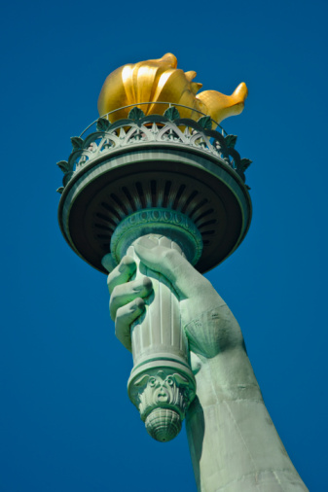
JUSTICE BASED ON LIBERTY
Liberals support freedom
of speech, association,
conscience and occupation.
Liberalism divided into 2
camps:
  Classical Liberalism
  Welfare Liberalism

Slide 30
Distributive Justice ; Summary
Egalitarian:
“To all the same.”
Meritocratic:
“To each according to their merit.”
Socialist:
“From each according to their ability, to each according to their need.”
Libertarian:
“From each what they freely choose to contribute, to each what they have made or others have freely chosen to contribute.”

Slide 31
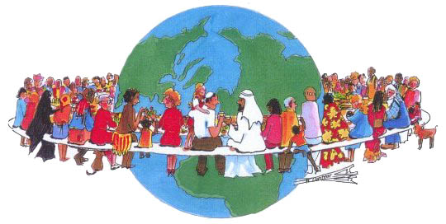
ROLE OF CITIZEN
What is the role of CITIZEN as
an individual and as a member
of the community in creating
a just society?

Slide 32

ROLE OF CITIZEN
Collective right and responsibility
to choose government, political
and electoral systems.
Express and bring to light any
instances of injustice witnessed.
Contribute towards the development
of a just society through education, activity,
awareness and shared responsibility.

Slide 33
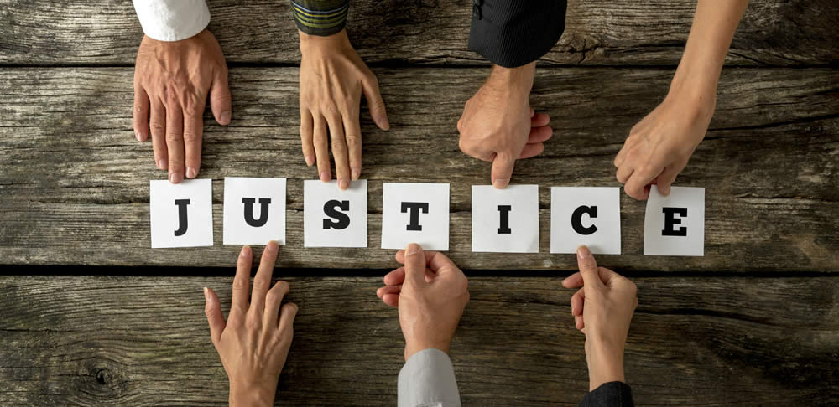
IMPORTANCE OF A JUST SOCIETY
Justice signifies order in society.
Justice is about fair and
common law, order,
political system, social
organization and personal
and political freedom.

